Slide 1
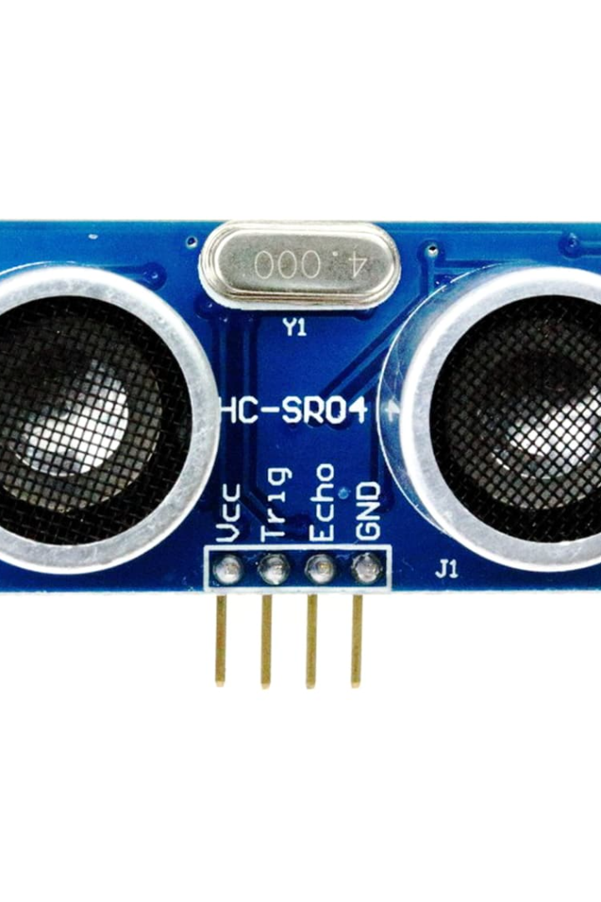
Discovering Ultrasonic Sensors
An ultrasonic sensor is a device that uses sound waves to measure distance, similar to a radar or sonar. These sensors are widely used in a variety of industries and applications due to their accuracy and reliability.
by M. SURENDRA

Slide 2
How Ultrasonic Sensors Work
1
Sound Waves
An ultrasonic sensor emits sound waves that bounce off nearby objects and return to the sensor.
Time of Flight
2
The sensor measures the time it takes for the sound waves to return, calculating the distance between the sensor and the object.
3
Output
The sensor outputs the distance measurement through an electrical signal.

Slide 3
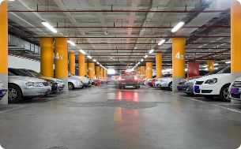
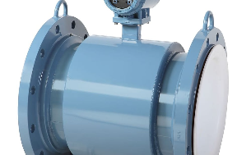
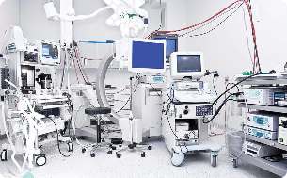
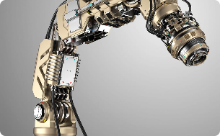
Applications of Ultrasonic Sensors
Automotive
Industrial
Medical
Used in parking and proximity sensors, collision avoidance systems, and blind spot detection.
Used in flow metering, level detection, and quality control.
Used in medical equipment such as blood flow monitors and ultrasonic scanners.
Robotics
Used in robots for object detection and distance measurement, allowing for precise movement and manipulation.

Slide 4

Advantages of Ultrasonic Sensors
1
Non-Contact
2
High Accuracy
Unlike contact sensors, ultrasonic sensors do not require physical contact with the object being measured, reducing wear and tear.
Ultrasonic sensors are highly accurate, allowing for precise measurement and control.
3
Wide Range
4
Reliable
This type of sensor can measure distances from a few centimeters up to several meters away, making it versatile for many applications.
Ultrasonic sensors are reliable even in harsh environments and can perform well in different temperatures and weather conditions.

Slide 5
Challenges and Limitations of Ultrasonic Sensors
Reflective Surfaces
Indoor vs Outdoor Use
Accuracy
Ultrasonic sensors can have trouble measuring the distance of objects with very reflective surfaces like mirrors or water, as the waves can bounce and create interference.
Ultrasonic sensors work better for indoor use or in environments with less air turbulence. Outdoor use can be affected by wind and other conditions.
While highly accurate, ultrasonic sensors may require calibration to maintain precision and reduce error over time.

Slide 6
Choosing the Right Ultrasonic Sensor for Your Project
Type
Measurement Range
Frequency
Choose between through-beam, retroreflective, or diffuse sensors depending on your application.
Higher frequency sensors are better for measuring small distances, while lower frequency sensors are better for larger distances.
Consider the distance you need to measure and choose a sensor with the appropriate range for your needs.

Slide 7
Conclusion and Key Takeaways
Ultrasonic sensors are an important tool in a variety of industries and applications, providing reliable and accurate distance measurement. When choosing a sensor, consider the type, measurement range, and frequency to ensure it meets your needs.

